Slide 1




“Pulmonary Disease Detection using Lung Sound”
Project Presented by:
Puspita Mobarak (2006087)
Al-Amin (2006088)
Muaz Rahman (2006089)
Mohammed Al Hosan (2006090)
Group: 06 Section: B1

Slide 2
Motivation
Global lung disease impact
Current diagnostic method drawbacks
Improved outcomes with early detection
Economic relief for healthcare

Slide 3
Literature Review

Slide 4
Existing Methods
Already existing methodology proposed by Islam MA which follows Welch Spectral Method using Machine Learning Deep Learning
Lung abnormalities also can be identified using Convolutional Neural Network and Deep Neural Network
Our Aim
Our study presents accessible method using MATLAB which is easy to learn and understand

Slide 5
Identification
COPD
Asthma
Bronchitis
Heart Failure

Slide 6
Proposed Methodology

Slide 7
Overview of Audio Detection Approach
Collecting Dataset
Comparison of Features
Audio Pre-processing
Characterize the Nature
Feature Extraction
Employ Audio Features

Slide 8
Collecting Dataset
Difficulty during collecting on field data
Using open source datasets on lung sound
A total of 2 open source datasets were used

Slide 9
Dataset Details (1)
”Α Respiratory Sound Database for the Development of Automated Classification” Rocha BM, Filos D, Mendes L, Vogiatzis I, Perantoni E, Kaimakamis E, Natsiavas P, Oliveira A, Jácome C, Marques A, Paiva RP (2018)
Recordings: 126 patients, 5.5 hours, 6898 respiratory cycles; 1864 crackles, 886 wheezes, 506 both
Asthma, Heart failure, Bronchitis

Slide 10
Dataset Details (2)
“A dataset of lung sounds recorded from the chest wall using an electronic stethoscope” Mohammad Fraiwan , Luay Fraiwan , Basheer Khassawneh , Ali Ibnian (2021)
Dataset: 112 subjects (35 healthy, 77 unhealthy); age 21-90; mean ±SD 50.5 ±19.4; 43 females, 69 males
Normal, Asthma, COPD, Bronchitis

Slide 11
Audio Preprocessing
Different lengths, sampling rates
Matching the sampling rate by resampling
Normalizing the amplitude
Matching the length using truncation
Saving the new audio files in a new location

Slide 12
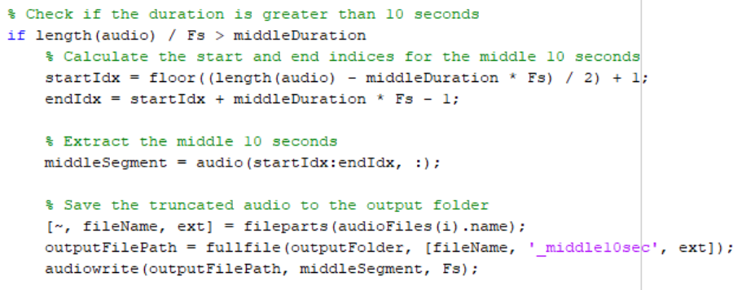
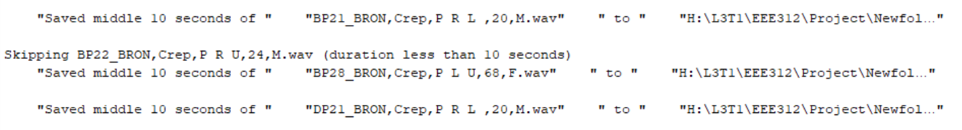
Resizing Audio Files

Slide 13
Feature Extraction

Slide 14
Feature Extraction using MFCC
Lung sounds are broken into manageable pieces.
Works on human perceivable sounds by patterns of lung sound
Divide the lung sound into small sections and analyze
Special filters are used to focus on specific parts of lung sound
At last, the important 12 features are extracted using MFCC.

Slide 15
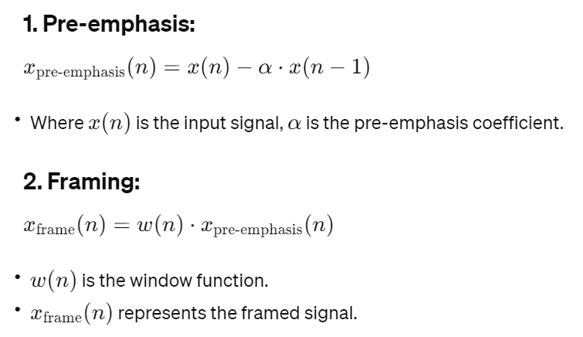
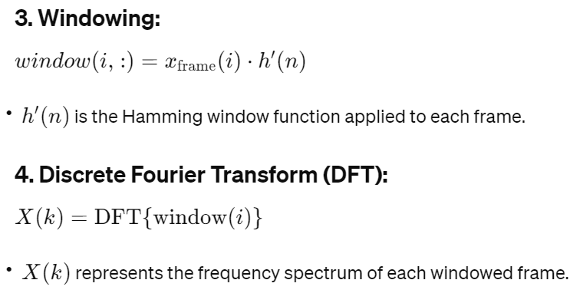
Mel-frequency cepstral coefficients (MFCC)

Slide 16
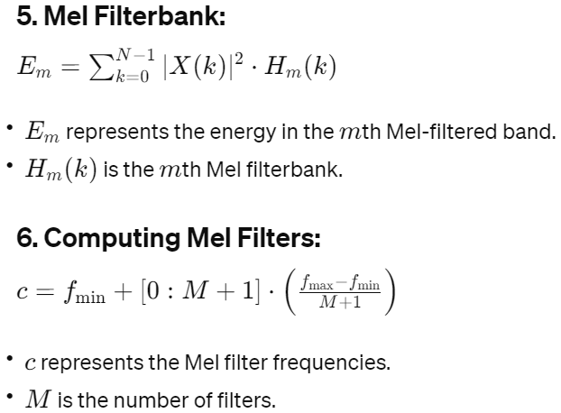
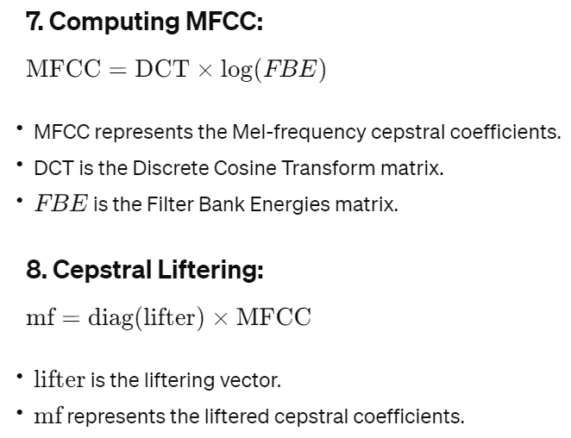
Mel-frequency cepstral coefficients (MFCC)

Slide 17
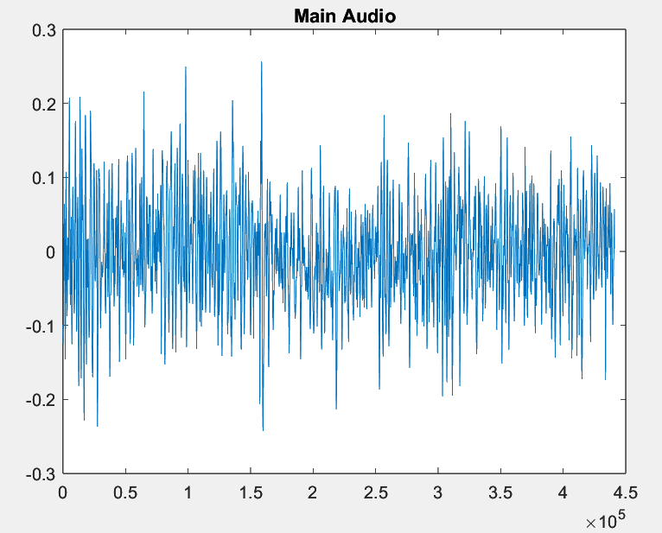
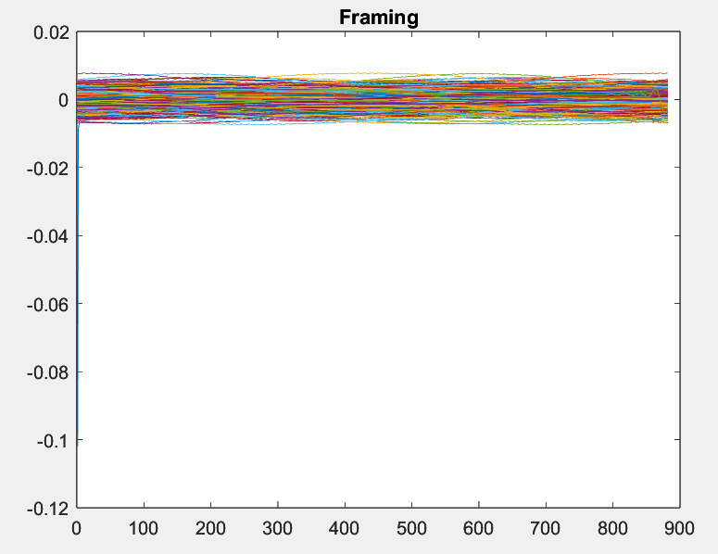
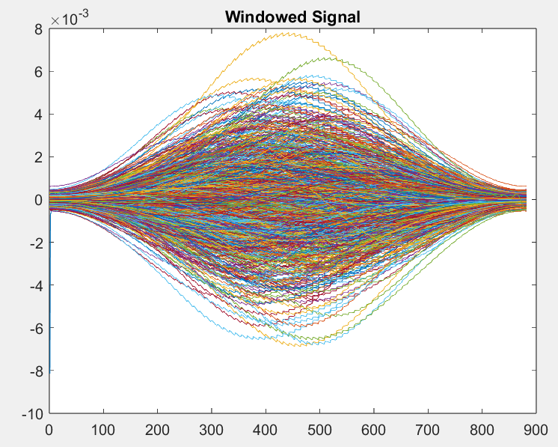
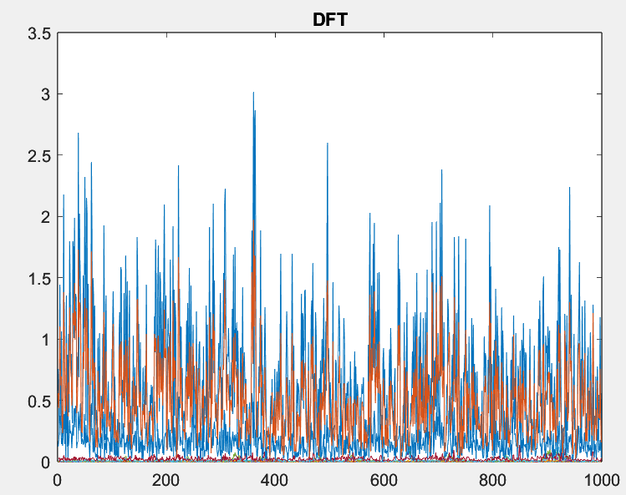
Mel-frequency cepstral coefficients (MFCC)

Slide 18
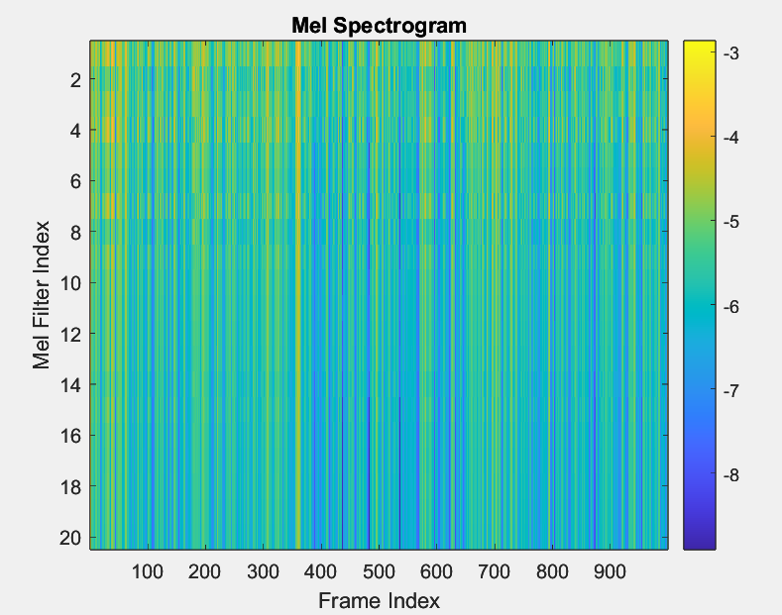
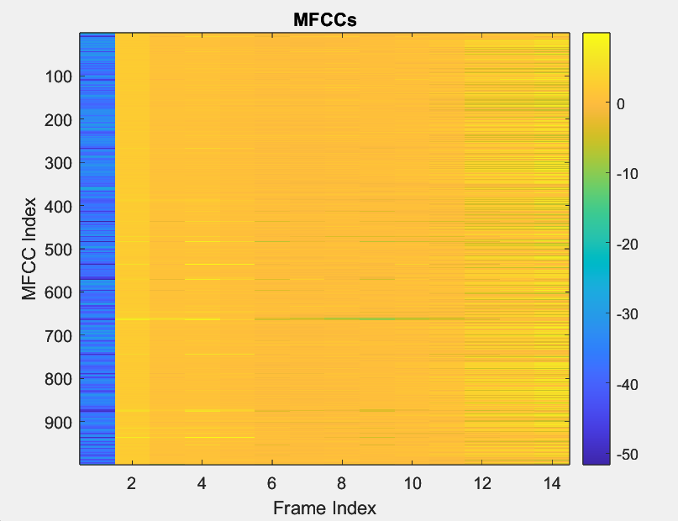
Mel-frequency cepstral coefficients (MFCC)

Slide 19
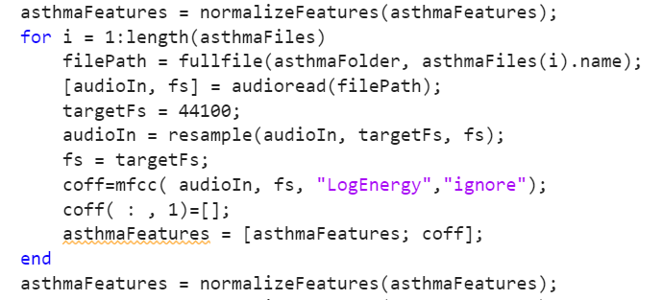
Feature Extraction For Asthma

Slide 20
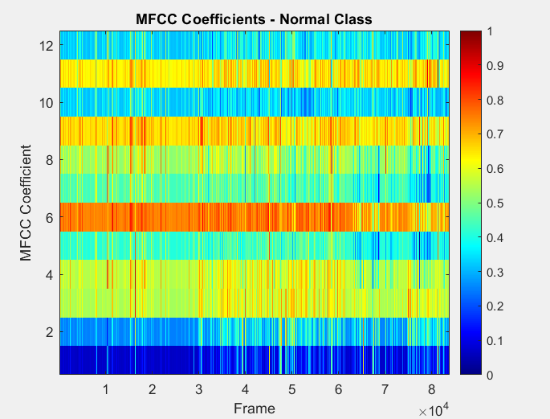
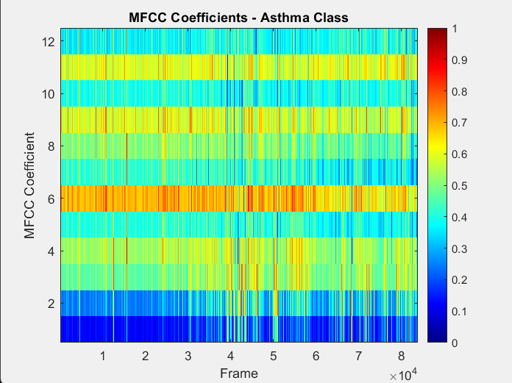
Feature Extraction using MFCC

Slide 21
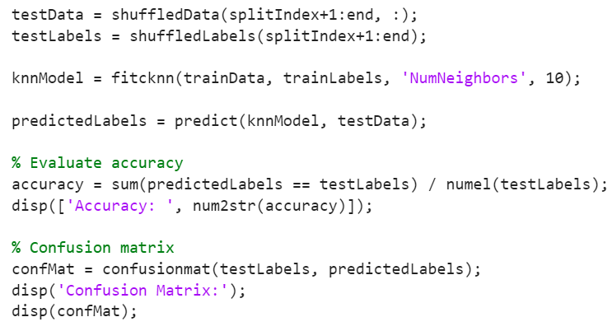
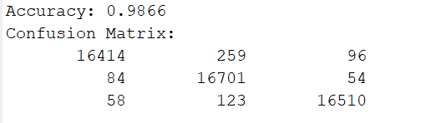
Accuracy Measurement and Confusion Matrix

Slide 22
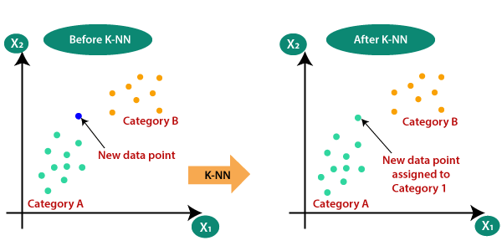
Classifier
K-Nearest Neighbors Algorithm (KNN)

Slide 23
Algorithm
Input: Training dataset, test dataset, value of 'k.'
Euclidean distance between test point sample point
Select the 'k' nearest neighbors.
Majority Vote

Slide 24
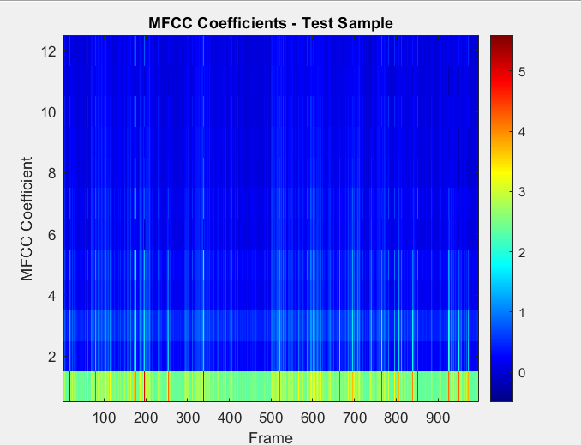
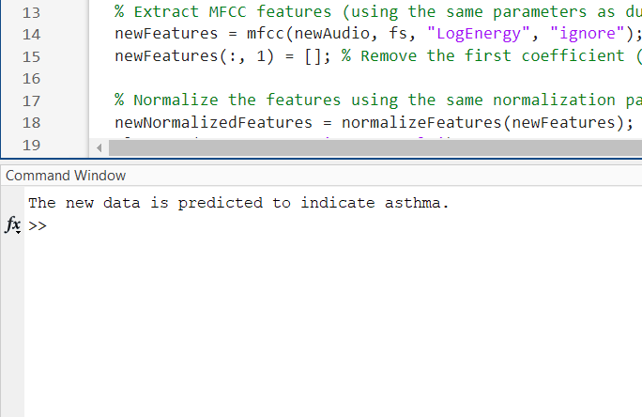
Prediction Using Test Data

Slide 25
Limitations
Dependency on Pre-Existing Dataset
Dependency on Pre-Existing Dataset
Dependency on Stethoscope Recording
Variability in Audio Data Dimensions
May mislead if data falls outside the dataset
Different input method for Different Dataset
Data taken in different chest location

Slide 26
Course Outcome
CO(4) | design a digital system to solve a relevant problem with due considerations to public health and safety, societal, cultural and environmental consideration
CO(5) | demonstrate application of ethical principles and practices in the project, and evaluate peer team members ethically
CO(6) | work effectively as an individual and as a team member towards the successful completion of the project
CO(7) | report effectively on the design done for CO4 with presentation, user-manual and detailed report

Slide 27
Program Outcome
PO(a) | Engineering knowledge | Pulmonary Disease Detection using Lung Sound using knowledge of Digital Signal Processing
PO(b) | Problem analysis | The problem involves detecting pulmonary diseases from lung sound data using MATLAB
PO(c) | Design/development Solution | Utilizes lung sound features and signal processing for disease detection in MATLAB.
PO(i) | Individual work and team work | Teamwork; Task distribution and mutual problem-solving support
PO(j) | Communication | Project report and presentation

Slide 28




Project flow & Work Distribution
Identifying Methodology, Literature Review
Extracting Data and Checking Previous Work
Result and Final Presentation
Puspita, Amin, Muaz, Al Hosan
Extracting Data: Amin, Puspita
Checking Previous Work: Al Hosan, Muaz
Puspita, Amin, Muaz, Al Hosan
Brainstorming Idea
Data Set Collection
Coding
Puspita, Amin, Muaz, Al Hosan
On-Field: Amin, Al Hosan
Online Data-Set: Puspita, Muaz
Puspita, Amin, Muaz, Al Hosan

Slide 29
Reference
1. D. Chamberlain; J. Mofor; R. Fletcher; R. Kodgule; R. Kodgule, “Mobile Stethoscope and Signal Processing Algorithms for Pulmonary Screening and Diagnostics,” 2015 IEEE Global Humanitarian Technology Conference (GHTC)
https://ieeexplore.ieee.org/document/7344001
2. Yongpeng Liu; Yusong Lin; Xingjin Zhang; Zongmin Wang; "Classifying respiratory sounds using electronic stethoscope";2017 IEEE SmartWorld, Ubiquitous Intelligence & Computing, Advanced & Trusted Computed, Scalable Computing & Communications, Cloud & Big Data Computing, Internet of People and Smart City Innovation;
https://ieeexplore.ieee.org/document/8397496

Slide 30
THANK YOU

